Slide 1
Which account is right for me?
HCFSA, HSA, & DCFSA
Auburn University
Notes:
Thanks for joining today to learn about a Flexible Spending Account and a Health Savings Account to determine which will best meet your healthcare needs.
My name is [presenter name] and I’ll be your host.​

Slide 2

Pay less for healthcare and maximize tax savings
Both FSAs and HSAs let you spend tax-free on eligible medical expenses.
FSAs and HSAs are never taxed at a federal income tax level when used appropriately for qualified medical expenses. Also, most states recognize FSA and HSA funds as tax deductible with very few exceptions. Please consult a tax advisor regarding your state’s specific rules.
Notes:
As you determine which account you want to enroll in, it’s important to note that both FSAs and HSAs let you spend tax-free funds you contribute on your eligible medical expenses.

Slide 3


Tax-free contributions for FSA and HSA
$50
earned income
Checking Account
FSA or HSA
Taxed
Not taxed
$10 to Uncle Sam
Keep all your money
$40
$50
Spending power
Spending power
Estimated savings are based on an assumed combined federal and state income tax bracket of 20%. Actual savings will depend on your taxable income and tax status
Notes:
​
The money you contribute to an FSA and an HSA is not subject to payroll taxes and income taxes, so you end up paying less in taxes and taking home more of your paycheck.

Slide 4
Healthcare Flexible Spending Account
FSA
Notes:
Let's look at a Flexible Spending Account (FSA) and the benefits it offers.

Slide 5

Get more flexibility with you FSA
Access annual contribution amount on day one
Fast, hassle-free payments and reimbursement
Pay for your spouse and eligible dependents too
Notes:
A healthcare Flexible Spending Account (FSA) is an employer-sponsored tax-advantaged account that lets you use pre-tax dollars to pay for eligible medical expenses from doctor's visits and dental work, to glasses and contacts, to prescriptions or over the counter medications---the list of eligible expenses continues to grow and may include products not covered by your insurance plan. ​
​
The FSA gives you access to your full contribution amount at the start of your plan year.​ You can make payments to service providers and easily get reimbursed for eligible expenses, And use your funds to pay for your spouse and eligible dependents healthcare needs.

Slide 6







Tax-free spending on eligible expenses
Medical care
Vision
Dental
Doctor visits
and copays
Hospital services
Telehealth
Eye exams
Prescription glasses/contacts
LASIK surgery
Teeth cleaning
Dental reconstruction
Orthodontia
Personal health
Alternative care
Mental health
Over-the-counter pain relievers
Period care products
Crutches
Chiropractic care
Acupuncture
Massage*
Therapy sessions*
Prescriptions
Treatment for substance
abuse disorder
*May require letter of medical necessity
HealthEquity.com/fsa-qme
HealthEquity and The FSA Store are separate, unaffiliated companies and are not responsible for each other's policies or services
Notes:
Here’s a glance at some of the most popular eligible expenses using FSA funds.
You can find eligible expenses to spend your funds on at healthequity.com/fsa-qme​ or by searching at www.fsastore.com
​

Slide 7
The more you contribute the more you save
Contribution limit | Tax savings*
$3,200 | $640
*Estimated savings are based on an assumed combined federal and state income tax bracket of 20%. Actual savings will depend on your taxable income and tax status.
Notes:
The 2023 maximum contribution limit for the FSA is $3,200. That’s a tax savings of over $600. if you estimate a 20 % tax rate.
​
Do keep in mind that if your spouse is contributing to a Health Savings Account, you may not be eligible to contribute to an FSA.​
​
​

Slide 8
FSA Carryover
Up to $640
Year 1
Year 2
Notes:
​
Your organization offers a carryover, letting you roll over up to $640 in unused funds from one plan year to the following plan year.

Slide 9


Smart spending starts with thoughtful planning
Notes:
In order to set up your Healthcare Flexible Spending Account, you want to take the time to:​
​
Estimate your anticipated yearly eligible healthcare expenses ​
Choose your election amount during Open Enrollment based on your estimation​
This is an important step because you generally can’t change FSA elections during the plan year unless you have a qualifying event (or during open enrollment)--- so it pays to plan ahead. ​
​

Slide 10

Providing documentation to verify eligibility
Notes:
Occasionally, you may be notified if your healthcare flexible spending account (FSA) debit card was used for an expense that cannot be automatically verified.
This doesn’t necessarily mean that the expense was not eligible, but that you need to provide additional documentation to verify eligibility.
HealthEquity makes it easy to submit the necessary information and gives you two quick ways to verify your transaction.

Slide 11
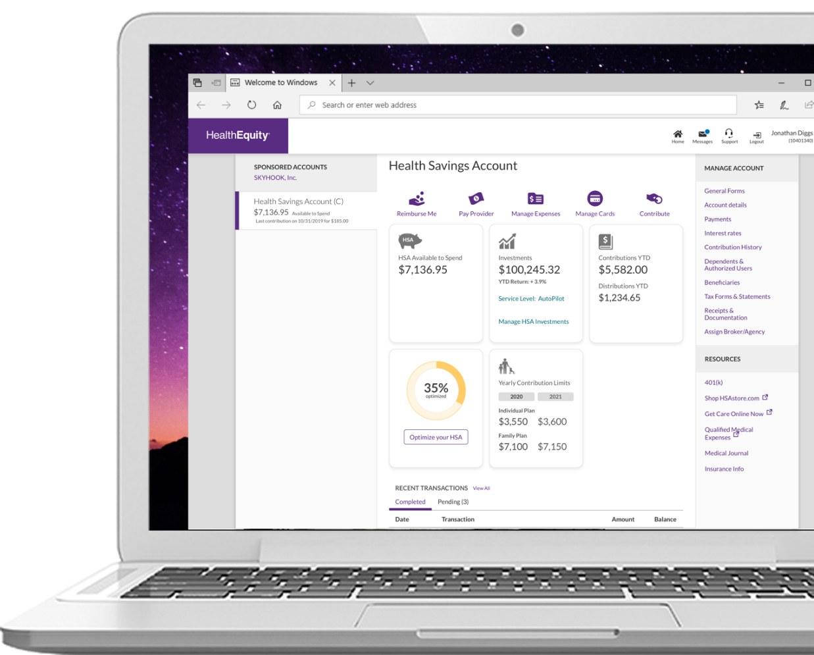
Log into your online account to upload documentation
Log into your account
Click Transactions
needing attention
Follow the instructions
to upload documentation
Notes:
The first way is to Log into your HealthEquity account. Click ‘Transactions needing attention’ and follow the instructions to upload documentation.

Slide 12

Download the EZ Receipts mobile app
On-the-go access
and history¹
Scan barcodes to
check product eligibility
Photo documentation
Send payments and reimbursements
Manage debit
card transactions²
Initiate claims and
view their status
¹Accounts must be activated via the HealthEquity website
in order to use the mobile app. | ²This card is issued by The Bancorp Bank; member FDIC pursuant to a license from Visa U.S.A. Inc. Your card can be used everywhere Visa debit cards are accepted for qualified expenses. This card cannot be used at ATMs and you cannot get cash back, and cannot be used at gas stations, restaurants, or other establishments not health related. See Cardholder Agreement for complete usage restrictions.
Notes:
A second way to submit the necessary information is by downloading and using the HealthEquity EZ Receipts mobile app for easy access to your accounts.

Slide 13
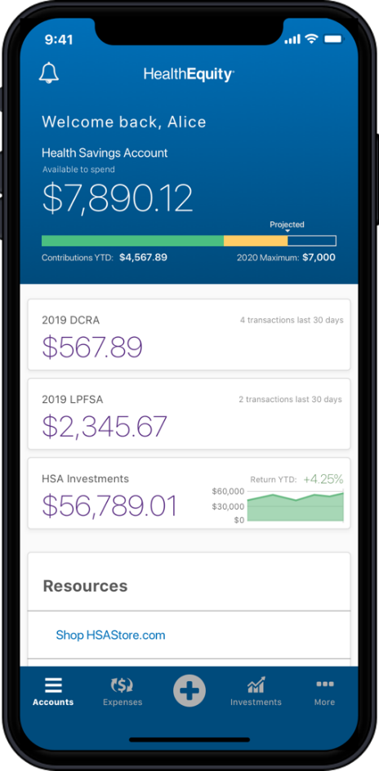
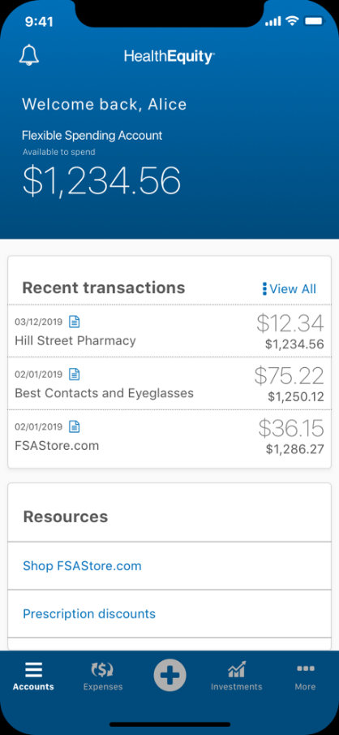
Follow the steps on the app to upload documentation and verify a transaction
Once you’ve opened the app, you can use the camera function to take a photo of your receipt or document.
Follow the instructions to upload your documentation and verify the card transaction you’ve selected.
Notes:
Once you open the app, you can use the camera function to take a photo of your receipt. Follow the instructions to verify your card transaction.

Slide 14

Why do I have to substantiate some transactions, but not all of them?
Notes:
Most card transactions are auto substantiated using several different methods.
If the card transactions cannot be substantiated through these methods, you will receive a “needs receipt” notice.
Substantiation is the documentation that will verify eligibility and you’ll need to go through the previously explained steps in your online account or on the mobile app to verify the transaction.

Slide 15

What’s needed for reimbursement
Documentation that includes
the following should be provided:
  Name(s) of provider(s)
  Name(s) of patient
  Date(s) of service
  Description(s) of services
  Cost(s) of service
Notes:
For quick processing of your FSA claims, you can submit reimbursement requests online or on the mobile app. Be sure that documentation like itemized statements from the provider includes:
​
Names of providers​ who you received services or care from
Name of patient​ who received the services or care
Dates of service​ (not date of billing)
Descriptions of services​--what specifically the patient received as services or care
Costs of services​
​
Note: Credit card receipts, canceled checks, and balance forward statements do not meet the requirements for acceptable documentation because they don’t include all of the necessary documentation details.​
​

Slide 16

Log into your online account
Log in to your online account or the mobile app to check account balances and spend down funds on eligible expenses
Notes:
As the plan year is ending, make sure you check your account balances and to spend down the funds you have to purchase eligible healthcare expenses.
This is especially important if you plan to switch to an HSA account if you previously had the FSA. If you do not spend down your FSA funds before the plan year ends, you will not be able to contribute to your HSA until after the runout period ends.
Please note that your FSA card is only loaded with the current plan-year’s funds. If you are needing to use Previous’ years FSA funds during the run out period, please submit those claims manually online or through the mobile app.
You can easily log in to your online account and see account balances or use the mobile app to log in and see account balances and spend those funds.

Slide 17
Health Savings Account
HSA
Notes:
Now we’ll discuss the Health Savings Account (HSA).

Slide 18

Get the 'triple-tax advantage' only with HSA
Tax-free contributions
Tax-free account growth
Tax-free spending for qualified medical expenses
HSAs are never taxed at a federal income tax level when used appropriately for qualified medical expenses. Also, most states recognize HSA funds as tax deductible with very few exceptions. Please consult a tax advisor regarding your state’s specific rules.
Notes:
HSAs are tax-advantaged, member-owned accounts that let you save pre-tax dollars for future qualified medical expenses. You can invest in mutual funds tax-free—and funds never expire.​
​Combining a HealthEquity Health Savings Account (HSA) with an HSA-qualified health plan delivers incredible benefits.​
​
HSAs are the only triple-tax advantaged accounts available. HSAs allow you to: ​​
Contribute tax-deductible funds ​
Grow tax-free earnings ​
And enjoy tax-free distributions (to cover qualified medical expenses)​

Slide 19
Your HSA funds roll over year after year
HSA balance
2020
2021
2022
2023
2024
2025
The examples used are for illustrative purposes only.
Notes:
You never lose your HSA dollars, so even if you’re only saving a small amount per month, those funds will grow into a medical care safety net for your healthcare needs.​
​
Money in your account rolls over year after year, even if you change health plans or employers. It’s important to know this account is yours, even if you move on to a new job, you don’t lose these funds. ​

Slide 20

Tax-free spending on qualified medical expenses
Medical care
Vision
Dental
Doctor visits
and copays
Hospital services
Telehealth
Eye exams
Prescription glasses/contacts
LASIK surgery
Teeth cleaning
Dental reconstruction
Orthodontia
Personal health
Alternative care
Mental health
Over-the-counter pain relievers
Period care products
Crutches
Chiropractic care
Acupuncture
Massage*
Therapy sessions*
Prescriptions
Treatment for substance
abuse disorder
*May require letter of medical necessity
HealthEquity.com/hsa-qme
HealthEquity and The HSA Store are separate, unaffiliated companies and are not responsible for each other's policies or services
Notes:
Because of the tax savings on contributions, you can save on qualified medical expenses, including but not limited to the expenses seen here.
Check out the most common eligible expenses at HealthEquity.com/hsa-qme. And to make finding HSA-eligible products easier, head over to hsastore.com for guaranteed eligibility on 2500+ products.

Slide 21
The more you contribute the more you save
Coverage | Contribution limit
Individual | $4,300
Family | $8,550
EMPLOYER CONTRIBUTIONS*
$250 (salary equal or more than $40,800) $450 (salary less than $40,800)
$500 (salary equal or more than $40,800) $900 (salary less than $40,800)
Members 55+ can contribute an extra $1000
*Employer contributions will be included in your total maximum contribution limit.
Notes:
For 2025, the individual coverage contribution limit is $4,300
And the Family coverage contribution limit is $8,550
Also—HSA members who are Age 55+: can contribute an extra $1,000
And remember that employer contributions are added in as part of your total yearly contribution limit.

Slide 22

If you are on an individual HSA
Because your
employer contributes
$250 (Salary more than $40,800) or $450 (Salary less than $40,800)
You will need
to contribute
$4,050 or $3,850
in order to reach the
maximum contribution limit.
Notes:
​
Because your employer contributes $250 for Salary more than $40,800 or $450 for Salary less than $40,800 if you are on an individual HSA, you’d need to contribute $4,050 or $3,850 in order to reach the maximum contribution limit.​
​
​
​

Slide 23

If you are on a family HSA
Because your
employer contributes
$500 (Salary more than $40,800) or $900 (Salary less than $40,800)
You will need
to contribute
$8,050 or $7,650
in order to reach the
maximum contribution limit.
Notes:
Because your employer contributes $500 for Salary more than $40,800 or $900 for Salary less than $40,800 if you are on an Family HSA, you’d need to contribute $8,050 or $7,650 in order to reach the maximum contribution limit.​
​
Note that the 55+ additional catch-up contribution of $1,000 doesn’t apply to the maximum amount. It is in addition to the contribution limit if you are eligible.​
​

Slide 24
If you love a 403(b), meet your new best friend
403(b) | HSA
FICA taxed contributions | 100% tax-deductible contributions
Tax-free earnings | Tax-free earnings
Medical expenses taxed as ordinary income | Tax-free distributions for medical expenses
Regular expenses taxed as ordinary income | Regular expenses taxed as ordinary income
Minimum distributions required | No minimum distributions
Plus, you can designate an HSA beneficiary and give the gift of health savings.
Notes:
In addition to using your HSA to cover your current health care needs, HSAs are also a way to build up your retirement funds for health care needs.​
​
Instead of paying taxes, the money is yours to use on your medical needs, or even just to save for the future. If you’re maxing out your 403(b) and Individual Retirement Account contributions and are looking for another place to invest in your future, your HSA is a great place to start.
​
You also want to designate an HSA beneficiary and give the gift of health savings.
If you're married, a good person to choose is your spouse. If your beneficiary is your spouse, then your HSA, upon death, becomes your spouse's HSA. The surviving spouse can continue to access HSA funds, and distributions for qualified medical expenses will be tax free, the same way they would be if distributed by the previous account owner.​
You can name a spouse, children, other individuals, or a trust as the beneficiary of your HSA. ​
​
However, beneficiaries other than a surviving spouse must include the full value of the HSA as taxable income in the year in which the account owner dies. So, unless you name your spouse as the beneficiary of your HSA, the account loses its tax-advantaged status as an HSA upon death of the account holder. ​
​
​

Slide 25
Investing keeps your future in focus
$100,000
Investing
$2,000 yearly
24 years
6% rate of return
$50,000
Savings
$2,000 yearly
24 years
.05% rate of return
Year 2
Year 4
Year 6
Year 8
Year 10
Year 12
Year14
Year 16
Year 18
Year 20
Year 22
Year 24
The example used is for illustrative purposes only. | Investments are subject to risk, including the possible loss of the principal invested, and are not FDIC or NCUA insured, or guaranteed by HealthEquity, Inc. Investing through the HealthEquity investment platform is subject to the terms and conditions of the Health Savings Account Custodial Agreement and any applicable investment supplement. Investing may not be suitable for everyone and before making any investments, review the fund’s prospectus.
Notes:
To illustrate the saving power of an HSA, let’s look at an example of a couple who contributes the maximum family amount each year to their HSA and decide to set aside $2,000 as part of their long-term health savings they will add each year.
If they decide to let this $2,000 simply roll over year after year for the next 24 years at a 0.05% rate of return without investing it, it will provide them with nearly $51,000 to use on health expenses in retirement.
If, however, they decided to take the same $2,000 and invest the funds, at an average 6% annual return rate, they would almost double that amount and have over $101,000 to use in retirement. Not only is this a significant portion of what they will likely need for healthcare expenses in the future, if used on qualified medical expenses, this money will never be taxed in retirement use.
Choosing to invest even a portion of your HSA and leave it invested each year can significantly increase your retirement health savings.
https://healthequity.com/calculator/future-balance
Savings scenario
Annual contribution: $2000
Rate of return: .5%
Years to calculate: 24
HSA estimated balance: $50,900
Investing scenario
Annual contribution: $2000
Rate of return: 6%
Years to calculate: 24
HSA estimated balance: $101,631.15

Slide 26

How do I get an HSA?
Sign up for a HDHP and meet these qualifications:
No access to a healthcare FSA
Not claimed as a dependent
on anyone’s tax return
Not enrolled in Medicare
Notes:
So how do you get an HSA?
​
Check that you’re covered only by an HSA-qualified plan and you do not have other health coverage (including spouse’s non-HSA plan, Medicare, Tricare, or a traditional health plan) ​
​
Verify you don’t have access to a healthcare flexible spending account (FSA) even through your spouse. ​
​
Make sure you’re not claimed as a dependent on anyone’s tax returns ​
​
Note: the minimum age to open an HSA is 18

Slide 27
HSA vs FSA​
​ | HSA​ | FSA​
Health plan type ​ | HSA-qualified ​ | Traditional ​
Premiums ​ | Lower ​ | Higher ​
Deductibles ​ | Higher​ | Lower​
Fund availability ​ | As you contribute | Start of plan year
Contribution limits ​ | $4,300 single*​ $8,550 family​* | $3,200**​
Fund expiration | Funds roll over year after year | Funds expire at end of plan year
*2024 contribution limits
** 2023 contribution limit
Notes:
Because many people are trying to choose between health plans that allow them to fund either an HSA or FSA let’s review some of the main elements of each:
HSAs pair with HSA-qualified health plans, sometimes called High Deductible Heath Plans. As a reminder, your deductible is the amount of money you have to pay for your health care before your health insurance plan will start to pay for medical services. Generally, a traditional health plan with lower premiums has a higher deductible and traditional health plans with high premiums have lower deductibles.
Premiums are what you pay—usually per pay period—to have health insurance. It doesn’t matter if you don’t use your insurance at all, you pay the full premium. Premiums are generally lower with HSA -qualified plans, allowing you to use your savings to fund your HSA.
The funds you contribute to your HSA never expire, they simply roll over year after year, and stay with you, even if you change health plans or employers.
Your HSA funds do not expire, while FSA funds have to be spent during the plan year
The contribution limits for an HSA and FSA also differ

Slide 28


Eligible expenses​
 | HSA | FSA
Deductibles/ copays
Vision and dental
Qualified medical expenses
Notes:
With each type of account, there are specific items and services that are eligible for reimbursement or fund use. You want to know that you’ve selected the right plan to cover the products and services in order to maximize your medical savings.
Eligible expenses are designated by the Internal Revenue Service and include medical, dental, vision and prescription expenses.
While, generally, premiums are not a qualified expense; there are instances where you can use an HSA to pay for insurance premiums (e.g., long term care insurance, COBRA, and Medicare)

Slide 29
Dependent Care Flexible Spending Account
DCFSA
Notes:
Let's look at a Dependent Care Flexible Spending Account (DCFSA).

Slide 30

Save on eligible dependent care expenses
Pre-tax payroll contributions
Fast, hassle-free payments and reimbursement
Enjoy a full year to spend your account funds
Notes:
A Dependent Care Flexible Spending Account, or DCFSA, is an employer-sponsored tax-advantaged account that lets you use pre-tax dollars to pay for eligible dependent care expenses. A qualifying ‘dependent’ may be a child under age 13, a disabled spouse or disabled child, or an older parent in eldercare.​
You contribute pre-tax dollars to use for payments to caregivers and service providers, and can spend funds as they accrue in your account.

Slide 31

Tax-free contributions
$50
earned income
Checking Account
DCFSA
Taxed
Not taxed
$10 to Uncle Sam
Keep all your money
$40
$50
Spending power
Spending power
Estimated savings are based on an assumed combined federal and state income tax bracket of 20%. Actual savings will depend on your taxable income and tax status
Notes:
The money you contribute to a DCFSA is not subject to payroll taxes and income taxes, so you end up paying less in taxes and taking home more of your paycheck.
For example, You'll have more spending power when you make tax-free contributions to your DCFSA rather than using post-tax funds.

Slide 32



A DCFSA is compatible with:
HSA
Health Savings Account
Healthcare FSA
Healthcare Flexible Spending Account
HRA
Health Reimbursement Arrangement
Notes:
You can still contribute to your healthcare accounts, including a Health Savings Account, Healthcare Flexible Spending Account, and Health Reimbursement Arrangement to pay for healthcare needs, while also contributing to a DCFSA. ​
​
If you or your spouse has any of these employer-sponsored accounts, you can pair them with a DCFSA.
​

Slide 33


Determine eligible dependents
Notes:
DCFSA funds can be used on any Eligible Dependents which may include: ​
A child under the age of 13 who resides with you and for whom you are entitled to claim as a dependent on your taxes. Keep in mind that if you are divorced, the child can still be a qualified dependent for you, if the child lives with you even if you have permitted the noncustodial parent to take the tax exemption. ​
DCFSA funds can also be used for an older child, spouse, parents, or other tax-dependent adults who reside with you and who are physically or mentally incapable of self-care. ​
​
​

Slide 34



Save on DCFSA eligible expenses
Childcare for children under age 13
Nanny and au pair services
Summer day camp
Preschool
Babysitting
Eldercare
Elder day care
Work-related custodial elder care
Care-associated costs
HealthEquity.com/
dcfsa-qme
Transportation costs to and from eligible care
Late pick-up fees
Notes:
There are a number of eligible expenses you can use funds for to care for your children who are under age 13. You may also use DCFSA funds to pay for care for your spouse or a relative who is physically or mentally incapable of self-care and lives in your home. ​
​
You can easily search for possible eligible expenses to use your DCFSA funds on at healthequity.com/dcfsa-qme​
​
Review your plan documents carefully and consult with your benefits team for a list of potentially eligible expenses.​
​

Slide 35
The more you contribute the more you save
Coverage | Contribution limit | Potential Tax Savings*
Individual | $2,500 | $500
Family | $5,000 | $1,000
*Estimated savings are based on an assumed combined federal and state income tax bracket of 20%. Actual savings will depend on your taxable income and tax status.
Notes:
Because a DCFSA must be used to help care for a dependent you claim on your taxes, DCFSA contribution limits are determined by your filing status.​
​
The contribution limit is $5,000 per household.​
If you are married and are filing a separate tax return from your working spouse, each of you can contribute up to $2500 each per year​
•If you are married and filing together, you can contribute $5000 per year as a household​
Note that if your spouse is a stay-at-home parent, then you cannot participate in dependent care FSAs. You and your spouse must both be working or have eligible student or disability status to participate in this benefit. ​
And remember, you may only use the DCFSA funds that are currently available in your account, not what you’ve elected for the plan year.​​
​​
As your contributions are made, you’re able to use tax-deductible funds and get reimbursed.

Slide 36

Qualifying life events
Marital status
Number of dependents
Employment status
Change in residence
New childcare or
eldercare provider
Generally these are qualifying life events. Check your plan to determine what are permissible qualifying life events.
Notes:
Your Dependent Care Flexible Spending Account may provide you with the flexibility to make the mid-year changes if you have a qualified life event.​ Such events may include:
A change in marital status, such as marriage, divorce, or death of your spouse​
A change in the number of your dependents, such as birth or adoption of a child​
A change in employment status for you, your spouse, or dependent that affects eligibility​
A change in residence for you, your spouse, or dependent​
A change in childcare or elder care provider, change in cost, or change in coverage. ​
​

Slide 37
What’s needed for reimbursement
Documentation that includes
the following should be provided:
  Name(s) of provider(s)
  Name(s) of person who received care or service
  Date(s) of service or care
  Description(s) of services
  Cost(s) of service or care
Notes:
For quick processing of your HCFSA, LPFSA or DCFSA claims, you can submit reimbursement requests online or on the mobile app. Be sure that documentation like itemized statements from the provider includes:
​
Names of providers​ who you received services or care from
Name of person who received the services or care
Dates of service​ (not date of billing)
Descriptions of services​--what specifically the patient received as services or care
Costs of services​
​
Note: Credit card receipts, canceled checks, and balance forward statements do not meet the requirements for acceptable documentation because they don’t include all of the necessary documentation details.​
​

Slide 38

HealthEquity makes saving easy
24/7 Member Services via call or chat
On-the-go access with our mobile app¹
Fast, hassle-free payment and reimbursement
¹Accounts must be activated via the HealthEquity website in order to use the mobile app.
Notes:
Whichever option you choose, HealthEquity makes saving easy, with our 24/7 member services’ availability, easy access mobile app, and hassle-free payment and reimbursement.

Slide 39

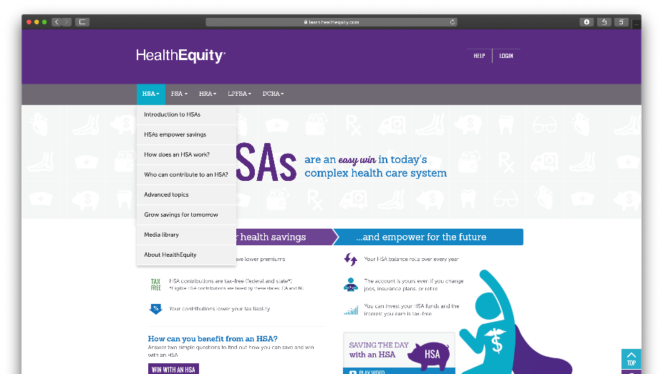
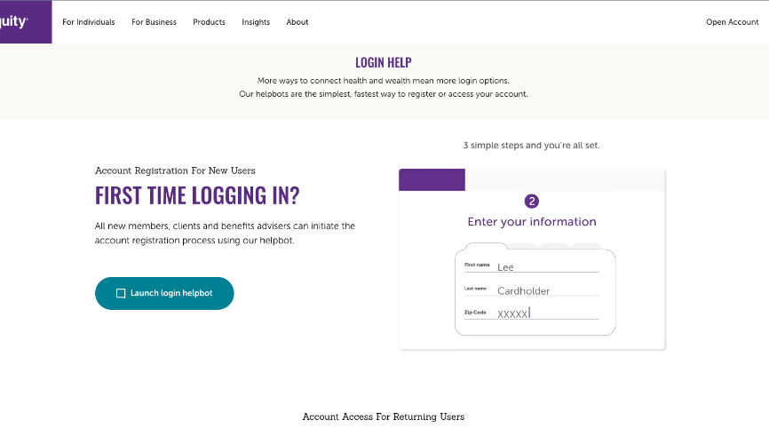
How to login
Enter your information​
Create username​
Create password​
HealthEquity.com/loginhelp
Notes:
To get started, go to HealthEquity.com and click Login to get started. You can also go to HealthEquity.com/loginhelp for help with getting started.

Slide 40

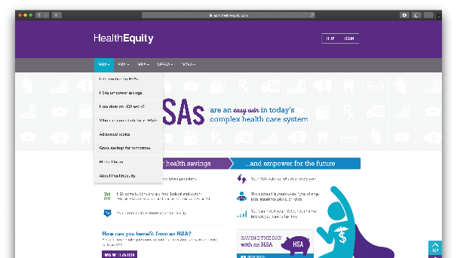
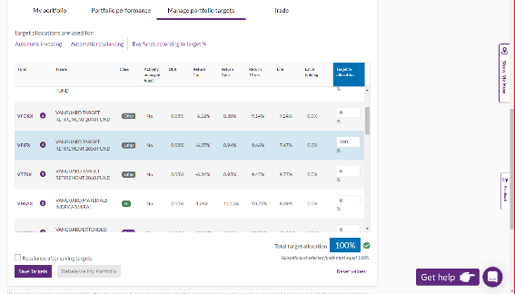

Step-by-step portal guides
TIP: You can launch on-screen step-by-step tutorials by clicking the Get Help button in the bottom right of the screen
The example(s) used is (are) for illustrative purposes only.
Notes:
If you ever need assistance, You can launch on-screen step-by-step tutorials by clicking the Get Help button in the bottom right of the screen

Slide 41
Get started today!
1
2
3
Sign up
Enrollment dates: October 1, 2024 -
October 31, 2024, at 4:45 pm
Enroll here:
aub.ie/oe
Choose election amount for the year for FSA accounts
Contribute
Pre-tax
through payroll
Amount withheld from each paycheck is typically equal
Access account
Register and login at www.HealthEquity.com/login
Submit for reimbursement via the HealthEquity online tool or mobile app¹
Remember to save
all receipts
¹Accounts must be activated via the HealthEquity website in order to use the mobile app.
Notes:
​
It’s easy to sign up, contribute, and use your healthcare flexible spending account or health savings account funds.​
​​
First you want to make sure you’re aware of your enrollment dates and where you need to enroll.​​ Enroll at aub.ie/oe
Then choose your election amount for the year (which typically cannot change)​​
​​
You’ll contribute pre-tax through payroll contributions and remember that you have your full amount of contribution funds available on the starting date of your plan year.​
​​
You will also want to register and log in at www.healthequity.com/login to start using your funds.​​
You can then submit reimbursement claims online or with the mobile app once you’ve registered your account. And downloaded the app.​
​

Slide 42

Four avenues for Questions:
Member Service available 24/7
Schedule an appointment with the Benefit Enrollers
Visit aub.ie/oe for Open Enrollment info
866.735.8195​ | learn.healthequity.com
Copyright © 2023 HealthEquity, Inc. All rights reserved.
HealthEquity does not provide legal, tax or financial advice.
Notes:
Our Member Services team is available 24/7, 365 days a year to take your calls and respond to any questions that you have about your HealthEquity account. You can even call before you have signed up to get your questions answered.
Also please note the other resources available to you during open enrollment to help get your questions answered.

